Slide 1
Anatomy of a Git Project

Slide 2
Getting to Know Git
SVN projects:
local workspace
and remote repository.
Git remote and local clones look exactly alike.
git init creates a local Git repo.
Three areas in a Git local repo:
Working area
Staging area (or Index)
Repository
HEAD points to the branch where your commits and checkouts will occur.
Git commands either:
move data between these areas
or move the current head
or run a report
Notes:
If you are from the SVN world, you probably have a local workspace and a remote repository for each project.
Git is much different. There is no difference between the structure of the remote machine and your local clones. (Any local git repo can be a remote as well)
git init creates a local Git repo.
There are three areas in a Git local repo:
Working area
Staging area (or Index)
Repository
There is one HEAD, that points to the branch where your commits and checkouts will occur.
Every local git command either moves data between the areas or moves the current head

Slide 3
Git - Initial setup
Install Git client from AMS: Git_Git-Gui-x64_2.15.1_EN_01
Generate SSH keys: https://gitlab.nomura.com/help/ssh/README
To create a new project in GitLab, create a Service Now ticket http://intranet.nomuranow.com/RFB/RFBController?action=viewRFBForm&FORM_ID=RF000008634
For more information, see DevOps Git Tactical Playbook: http://gm-dev-tools.nomura.com/ETCB/confluence/display/DEVOPS/Playbook+-+GitLab
Optimizations for Git Bash slowness: https://blog.praveen.science/solution-to-git-bash-is-very-slow-in-windows/
git config --global core.preloadindex true
git config --global core.fscache true
git config --global gc.auto 256

Slide 4
Git – Common Left to Right Workflow
Working area | Staging Area | Repository (local) | Remote (origin)
> git init # create a local repository
<< create or update files >>
> git add . # copy files to staging area
(git rm --cached <file> # opposite of git add)
> git commit – m “message” # commit staging area to repository
(git commit –a is the same as git add followed by git commit)
> git push # push the commit to the remote
-
Legend
Untracked
Uncommitted
Committed
Notes:
Once you do an init, you can start versioning anything under that directory. No need for a remote

Slide 5
Git – clone
Working area | Staging Area | Repository (local) | Remote (origin)
# init local repo and copy remote to local
> git clone
Legend
-
Untracked
Uncommitted
Committed
Notes:
Once you do an init, you can start versioning anything under that directory. No need for a remote

Slide 6
Git – checkout
Working area | Staging Area | Repository (local) | Remote (origin)
# copy branch to working area
Note checkout will overwrite local changes
> git checkout <branch>
Legend
-
Untracked
Uncommitted
Committed
Notes:
Once you do an init, you can start versioning anything under that directory. No need for a remote

Slide 7
Git – Soft Reset
Working area | Staging Area | Repository (local) | Remote (origin)
> git reset --soft <commit# or branch or HEAD>
-
# moves the HEAD pointer to the specified commit
# Does not touch staging or working areas
Legend
Untracked
Uncommitted
Committed
Notes:
Once you do an init, you can start versioning anything under that directory. No need for a remote

Slide 8
Git – Mixed reset
Working area | Staging Area | Repository (local) | Remote (origin)
> git reset <commit# or branch or HEAD>
-
# copy commit to staging but not working area
(-- mixed is default)
Legend
Untracked
Uncommitted
Committed
Notes:
Once you do an init, you can start versioning anything under that directory. No need for a remote

Slide 9
Git – hard reset
Working area | Staging Area | Repository (local) | Remote (origin)
> git reset --hard <commit# or branch or HEAD>
Legend
-
# copy the commit to staging and working areas
# and moves HEAD pointer to that commit
Untracked
Uncommitted
Committed
Notes:
Once you do an init, you can start versioning anything under that directory. No need for a remote

Slide 10
-
Git – fetch / merge / pull
Working area | Staging Area | Repository (local) | Remote (origin)
> git fetch
Legend
# update from remote to local. HEAD pointer not changed
Untracked
> git merge
Uncommitted
# merges the commits and advances the HEAD pointer
Committed
<< git pull == git fetch + git merge >>

Slide 11
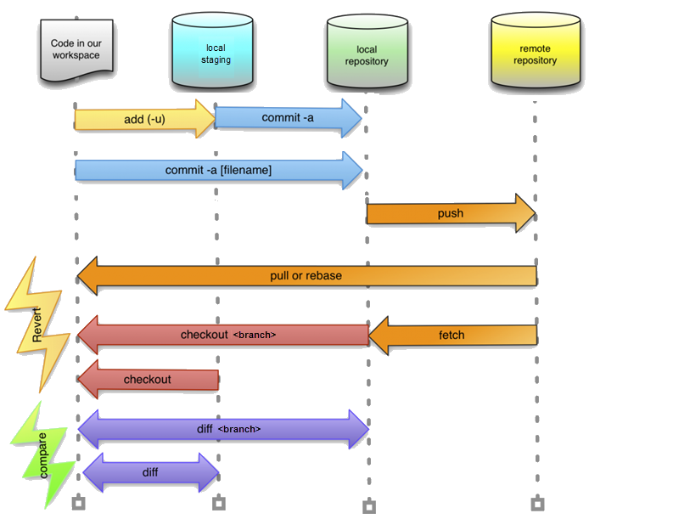
Notes:
git init
git status
git add
(to delete a file from Git, delete it locally, then do git add <file> then git commit
gitk – open git log browser
git commit –m “message”
git branch
git branch <name>
git branch –d <name> // delete branch
HEAD points to a branch, branch points to the commit
branch points to a commit
add git --cached

Slide 12
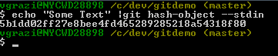
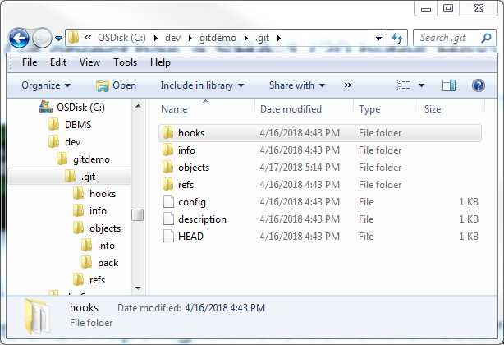
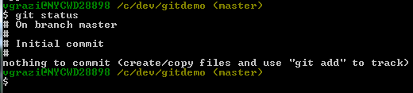
Digging in
Every Git object has a SHA-1 (20 bytes Hex)
echo “Some text” | git hash-object –stdin
git init - creates a Git repo
right in the current directory:
git cat-file -p <sha-1> Displays the object content
git status

Slide 13
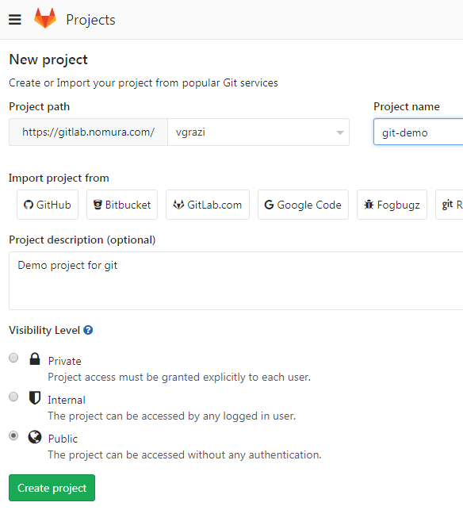

Recommend using Git Bash, installed as part of the Git installation
If you like Unix commands, this provides a highly usable unix Bash shell in Windows
To create a new project in Gitlab:

Slide 14
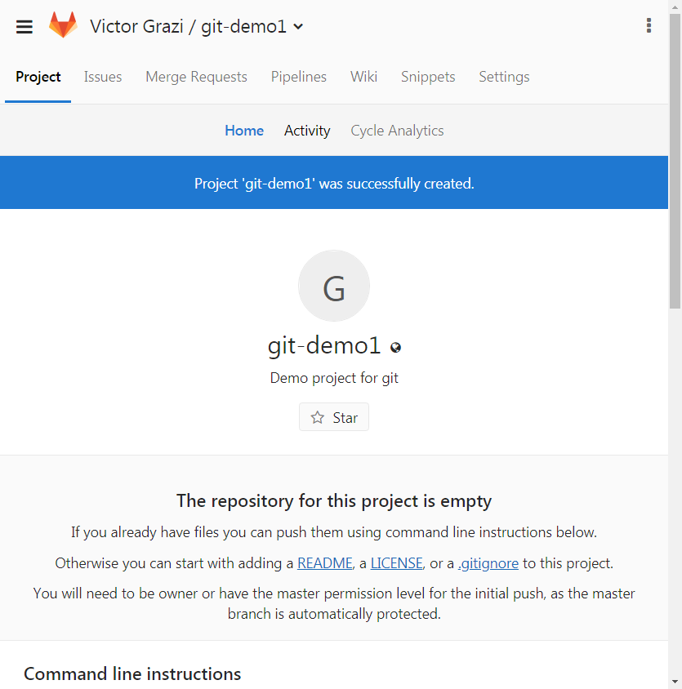
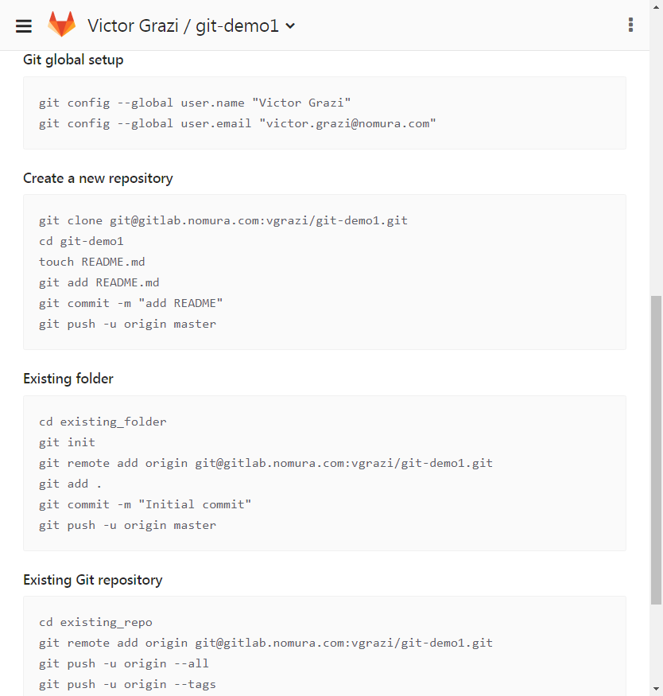

Slide 15
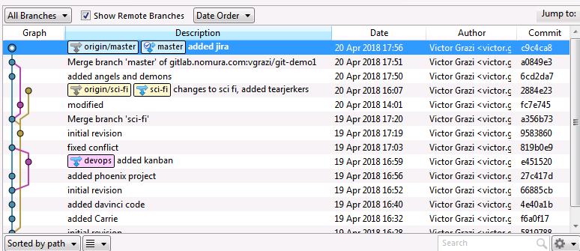
Git –
Notes:
Once you do an init, you can start versioning anything under that directory. No need for a remote

Slide 16
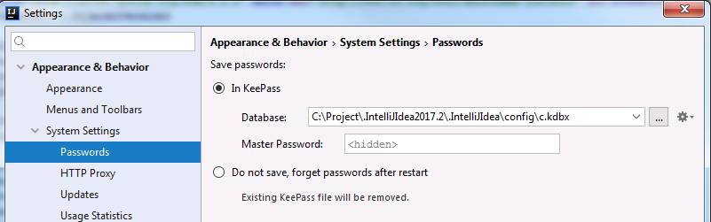

Slide 17

git ignore
IntelliJ
FMI https://www.jetbrains.com/help/idea/using-git-integration.html
Local changes (Alt-9)
In file markers:
Ctrl-A Annotate – click to show files in the commit, click to show diffs
Ctrl-Shift-Alt Down/Up arrow to navigate to next/previous change
View/ Restore changed lines
Ctrl-K Stage area
Ctrl-T
log
cherry pick
stash/
squash
reset
revert

Slide 18
More information
Git documentation: https://git-scm.com/doc

Slide 19
What is a commit?
HEAD
021e638 Oct 19 12:51 Victor Grazi: done!
HEAD
bf1599d Oct 17 12:49 John Jones: almost..
HEAD
a641e01 Sep 15 12:46 John Jones : more stuff
HEAD
9aca92f Aug 21 12:42 Victor Grazi: some stuff
HEAD
6e33d1c Aug 17 12:21 John Jones: modified
HEAD
fed59d6 Jul 17 11:45 Victor Grazi: initial

Slide 20
What is a branch?
fe1632
HEAD
932f60a
HEAD
021e638
HEAD
a641e01
HEAD
3f1509d
HEAD
bf1599d
HEAD
9aca92f
HEAD
6e33d1c
HEAD
de159d6
HEAD
my-branch
master
other-branch

